Slide 1

“It is not the strongest species that survive, nor the most intelligent,
it is the one most adaptable to change.”
~ Charles Darwin
Image Source: www.insideoutretreats.com

Slide 2

Global Healthcare Entrepreneurship
Session 4: Digital Health

Slide 3
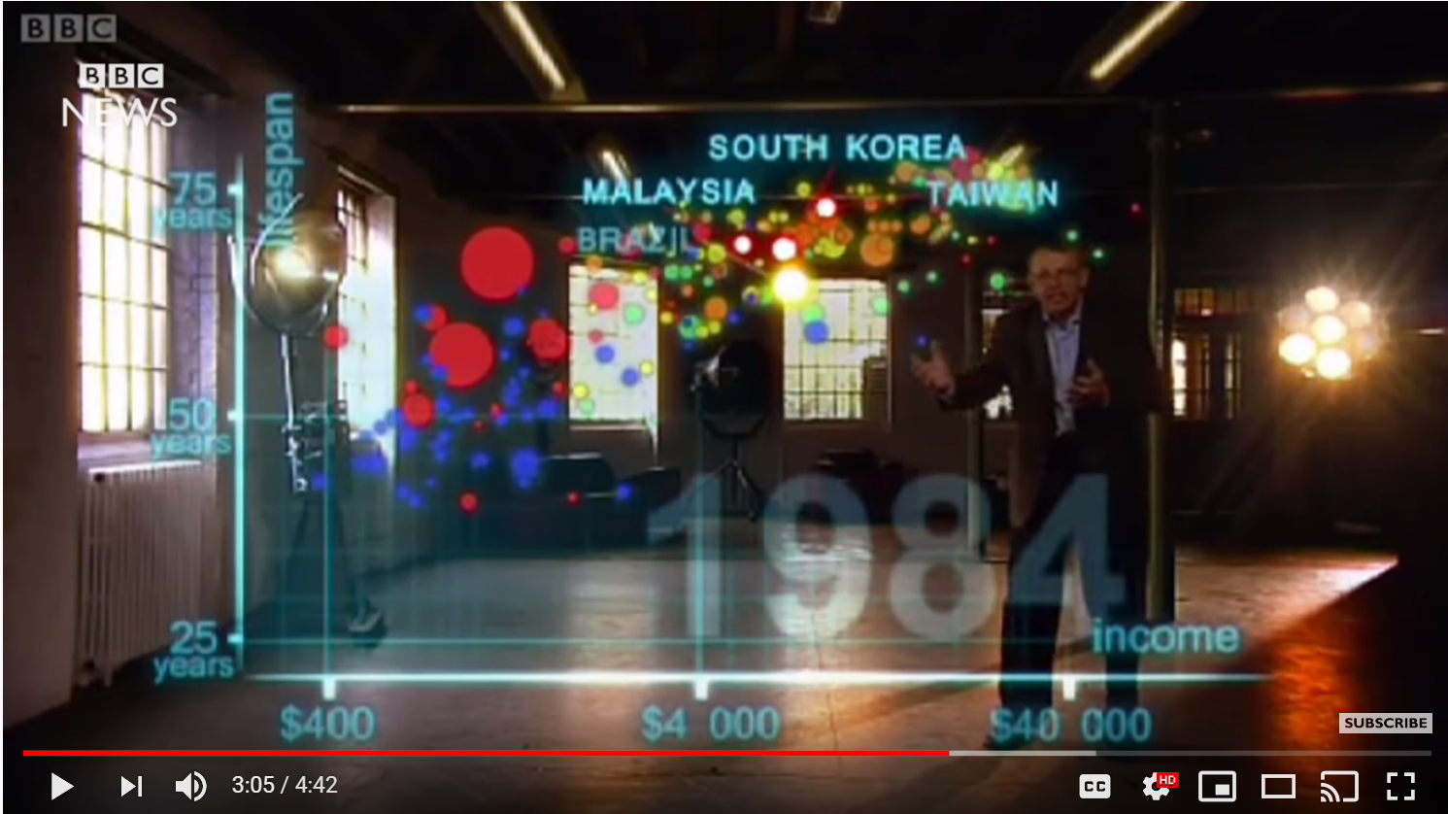
A Story of GLOBAL Healthcare Equity

Slide 4
Agenda
Frameworks for Digital Health
My Digital Health Journey
Digital Health and the Importance of Data
Artificial Intelligence in Digital Health
Mini-Case Presented as 5 Questions
Participant Q&A
What to remember from today

Slide 5
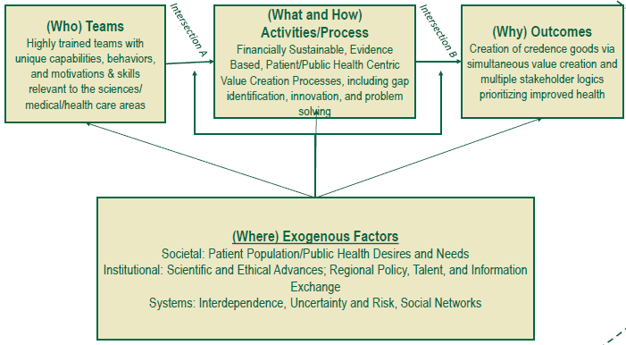
Where it began: Areas for Entrepreneurship

Slide 6
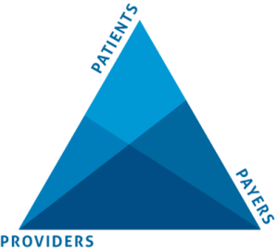
The 3 (maybe 4) Ps…
The 4th P: POLICY MAKERS

Slide 7
Let’s Talk about Policy Makers – in Rwanda
Health insurance became mandatory in 2008
96% Coverage by 2012
~60,000 Community health workers
~15,000 Villages
~700 Health Posts
~500 Health Centers
~40 District Hospitals
4 National Referral Hospitals
1 University for Global Health Care Equity

Slide 8
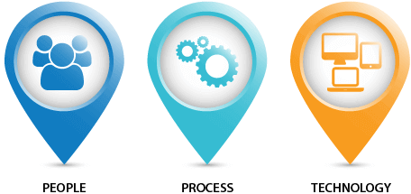
Doing it right…
…means doing it in this order

Slide 9
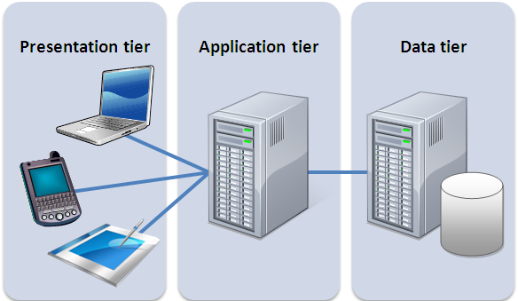
COMPONENTS OF A SOFTWARE SYSTEM
User Interface
Processing
Data Base

Slide 10
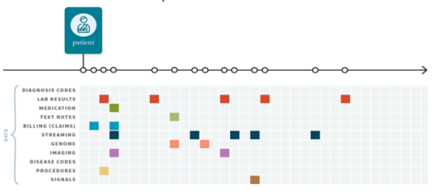
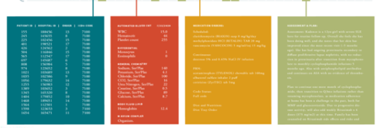
Health Data Timeline / Disparate Data Types
Diagnoses
Labs
Prescriptions
Notes

Slide 11

A Case Study from Ghana – CLODS EHR

Slide 12
Digital Health and My Journey

Slide 13

My Background
Congenital Health Issue
  Couldn’t walk until 14
  Instilled Passion for Healthcare
BS in Engineering / MS Comp Sci
GE Healthcare (Med device)
ViryaNet – IPO
MBA – Entrepreneurship (Babson)
Tele Atlas – sold to Tom Tom
Ika Systems (sold to BCBS MI)
Started Ankota (CEO/CTO)
Adjunct Professor (Babson)

Slide 14
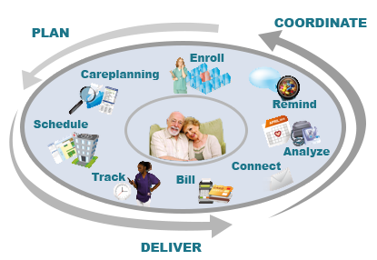

Ankota provides “ERP System” for Home Care
Keeping elderly and disabled living at home

Slide 15
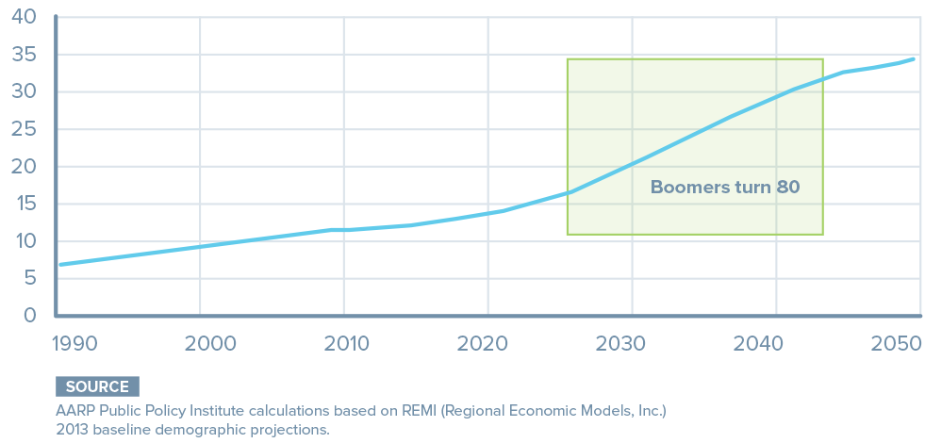
Growth is Fueled By Baby Boomers and Life Expectancy
Americans over 80
Now
Market will more than double

Slide 16
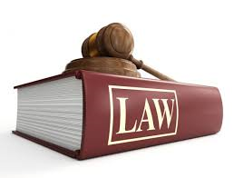
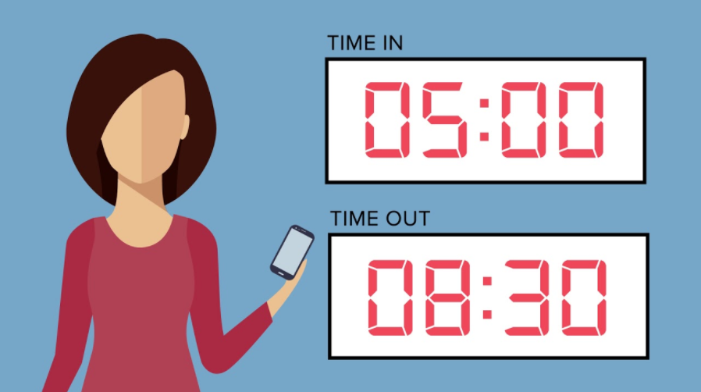
Electronic Visit Verification (EVV) Mandate
Mandated by the 21st Century Cures Act
Agencies need software like Ankota by end of 2021

Slide 17
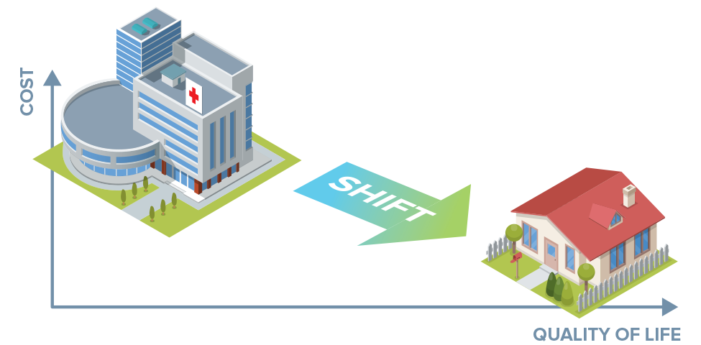
Further Fueled by Payment Reform (Value-Based)
Rewards prevention of Hospitalizations
Market Expands to Health Systems / Population Health

Slide 18
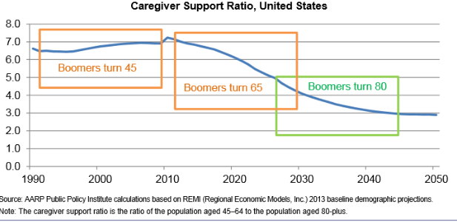
Biggest Industry Risk is Shortage of Caregivers
Our proposed solution is to enable Adult Day Centers
(but due to Covid-19 this will come in the fall)

Slide 19
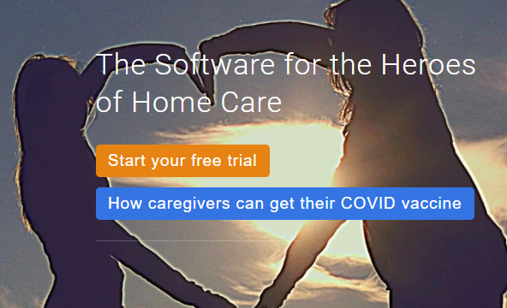
Our messaging for 2021 is…
The Software for the Heroes of Home Care

Slide 20
Digital Health and The Importance of Data

Slide 21

Amazon is data-driven
“The most junior person in the company can win an argument with the most senior person with a fact-based decision.”
- Jeff Bezos
■ Measure everything ■ Provide access to all ■ Only data-driven decisions
SISense 2014

Slide 22
“From the dawn of civilization until 2003, humankind generated five exabytes of data. Now we produce five exabytes every day…. And the pace is accelerating.”
Eric Schmidt, Executive chairman, Google

Slide 23
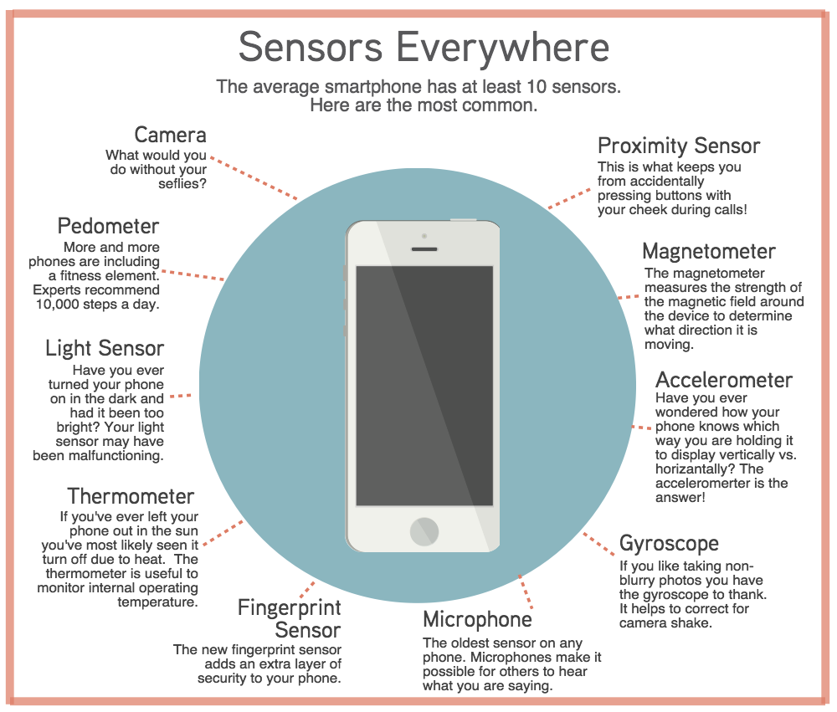
Everyone is a Source of Data

Slide 24
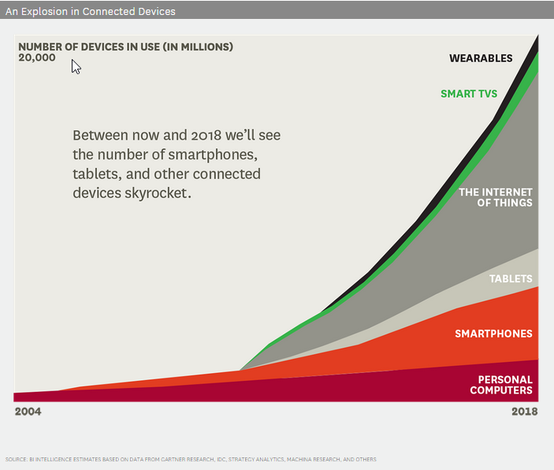
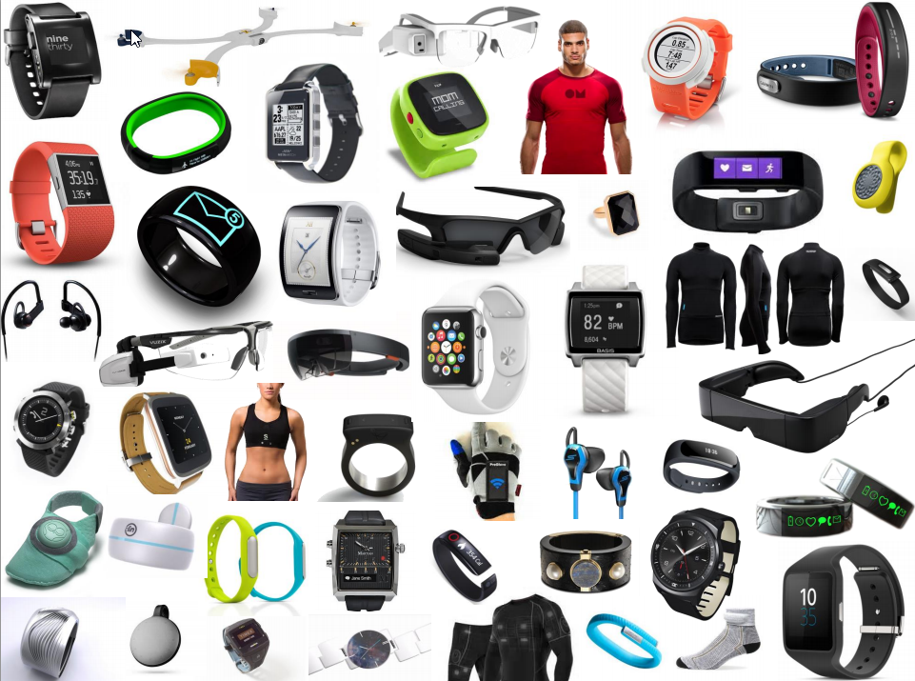
Explosion of Connected Devices

Slide 25
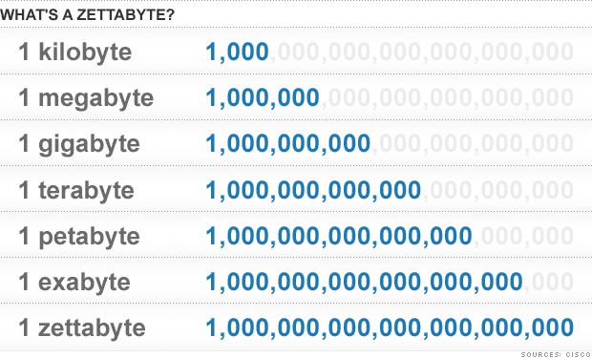
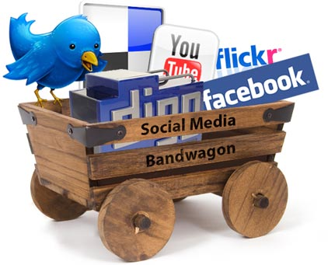
Big Data Pushes the 3V’s
Bigger and Bigger Data!!!
Unstructured
Structured
Video
Mobile
Location
Photos
Audio
Images
Text
MB GB TB PB EB ZB YB …
… Social Media Web Database Table
Variety
Volume
Batch
Periodic
Near-Real Time
Real-Time
Streaming Data Use Cases
Intrusion detection (John Hopkins University)
Detection of heavy traffic compared to the norm (Stockholm)
Neonatal unit at University of Ontario
Velocity
Based upon an image by Diya Soubra, July 5, 2012, as posted on Linguamatics.com

Slide 26
AI and other Trending Digital Health Tech

Slide 27
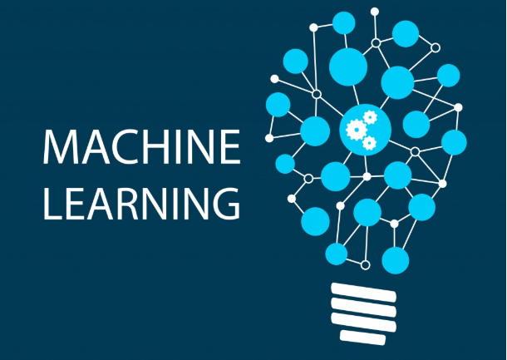
(and Deep Learning)

Slide 28
Everyday AI/ML Examples
Gmail finishing your sentences
Amazon: People who bought ____ also bought ____
Bank deposit: reading amount off check
Alexa / Call centers: what question are they asking?
Medical Diagnosis: These symptoms may mean ____
Netflix: Recommended for you
USPS: What zip code did they write down?
Google: What Ads are they likely to click?
Fingerprint and Facial Recognition
Women’s Health: Should mammogram be followed by biopsy
Gmail: Is this spam?
Will stock go up or down
Who is likely to show up in the Emergency Room

Slide 29
Based on these examples, which is the best description of Artificial Intelligence (and specifically machine learning)?
A) Something very complicated that should only be attempted by the best scientists on the planet?
B) Applying easy math (statistics) on big data?
(multiple choice)

Slide 30
The following terms are nearly synonyms
Data mining
Pattern Recognition
Computational Statistics
Predictive Analytics
Artificial Intelligence

Slide 31
What is Machine Learning?
Computers performing specific tasks without instructions, but rather by relying on patterns and inference
Role of Statistics: inference from a sample
Role of Computer science: efficient algorithms to
  Solve an optimization problem
  Represent and evaluate the model for inference

Slide 32
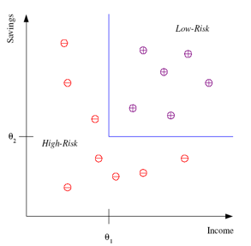
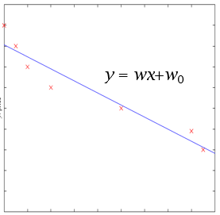
Two types of algorithms used (of many)
Classification
  e.g., Credit Score
  (savings/income)
Regression:
  e.g. price of used car
  X = characteristics of car
Price
Mileage

Slide 33
How to Develop a Machine Learning Model
Training Data
Training
Data with Labels
Prediction
Model: Map Input to Output
New Data
Split
Test Data
Test
Input: words of news
Output: politics, sports, entertainment, …
Training: Build a model (classifier)
Test: Test the model
Key idea: Learn from known data and Generalize to unseen data

Slide 34
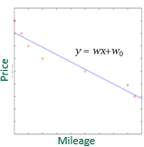
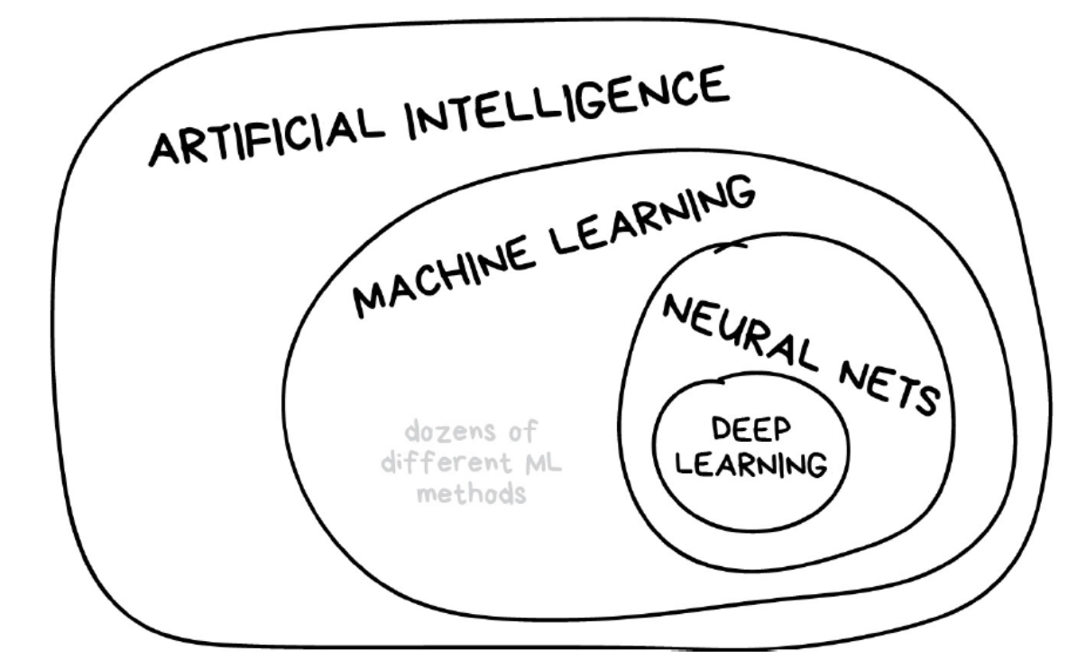
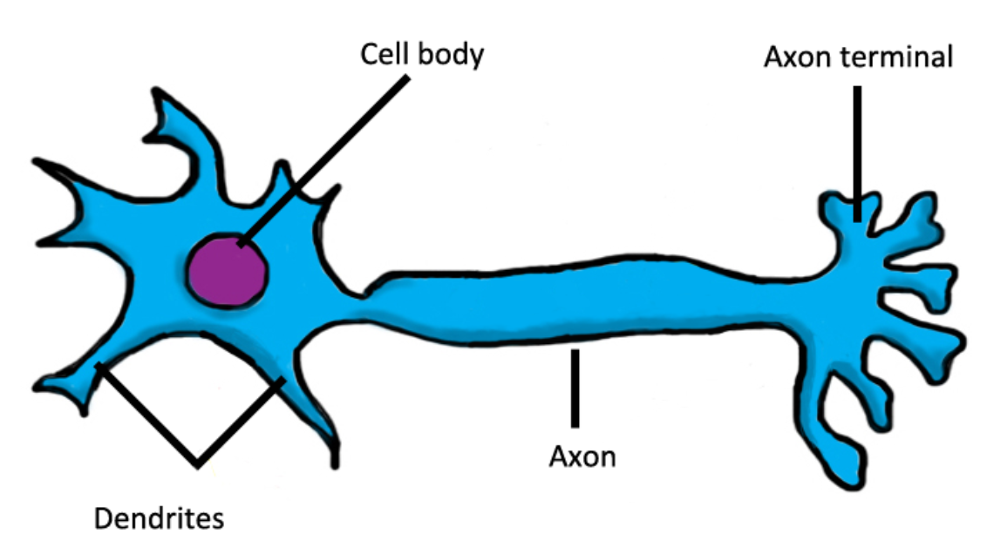
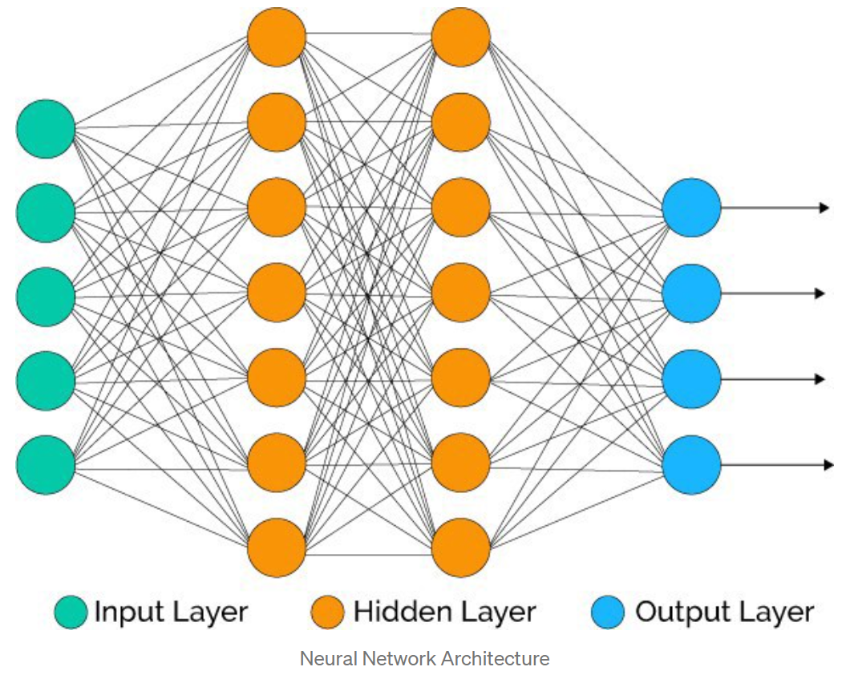
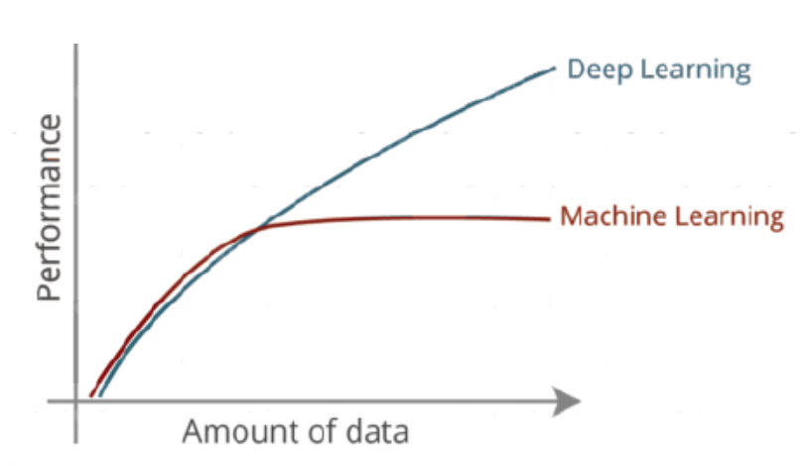
A Quick Nod to Deep Learning (DL)
Machine Learning (ML) is based on statistics and algorithms
By contrast, Deep Learning (DL) attempts to solve the same problems more like a human.
In humans, Neurons “fire” and advance our thinking to the “next level”
Example: a 3-year old who has seen <50 cats and dogs ever can generally tell a cat from a dog better than the algorithm of an undergrad.
Rather than a “mathematician”
“building an algorithm” a DL model
constructs neural net like a person

Slide 35
How all these pieces tie together

Slide 36
Bringing Our Big Data Conversation Together
See next slide for explanation
IoT
Big Data
Value!
Cognitive Computing
BI
AI
Notes:
Machine intelligence is based upon data – lots of data!
IoT makes big data even bigger!!! (often called big data on steroids!)
AI and XR systems will help extract value from big data – beyond what humans and traditional systems are capable of extracting.
AI and XR systems also require enormous volumes of data (big data) to function in a way that creates value.
In other words, the topics we covered – IoT, Big Data, AI, and XR share a highly symbiotic relationship – but the most common theme across all is data!

Slide 37
Mini-Case:
Population Health in 5 Questions

Slide 38
Assume we have community health workers who can identify the individuals in their community with the highest risk (of emergency care)…
How can we check in on these individuals somewhere between daily and weekly?
(word graph)

Slide 39
Can we have a medical person explain (to the businesspeople) what CHF (Congestive Heart Failure) is and the “clinical pathway” for detecting its recurrence?

Slide 40
Presuming that we can’t deploy electronic scales or blood pressure cuffs to our population, what’s another way that we can detect recurrence?

Slide 41
If we could think of questions that we can ask that would give us early warnings signs of emergency hospitalizations and roll it out through our community health workers, could we save lives and reduce the costs of emergency care?
(Yes / No)

Slide 42
Once this is rolled out and we have data about how these questions are helping us predict and prevent emergencies, can we imagine using “machine learning” to make the predictions better?
(yes / no)

Slide 43
Q&A from the Cohort

Slide 44
Digital Health Conclusions

Slide 45
Things to Remember from Today
Ample Opportunity to Innovate in Dig Health
  Providers, Payers, Patients, Policy
  People first, then Process then Technology
  Leading Edge is Big Data and AI
MOST IMPORTANT: Make an Impact
  Bring Care and Automation where it can help
  Look for the simple way to make life better
  “Eat the Low Hanging Fruit”

Slide 46
Global Healthcare Entrepreneurship
Session 4: Digital Health

